Slide 1

Diagnosing childhood asthma
When to suspect, when to test, differentials, when to refer…
Dr Chinedu Nwokoro – MB BChir MA Hons (cantab) MD MRCPCH

Slide 2
What I’m going to talk about…
Diagnosing childhood asthma
NICE and NICE-r
When to refer
When it doesn’t fit

Slide 3
Diagnosing Childhood Asthma – Why?
Accurate diagnosis is fundamental
Appropriate treatment → reduced morbidity
Compliance
Resource planning
Prognosis
Exclude important differentials
Phenotyping
Guides treatment

Slide 4
Diagnosing Childhood Asthma – Suspicious History
Wheeze
- (smartphone, expiratory, not ruttles, ED records)
Cough
- (usually dry, nocturnal, prandial?)
Symptom pattern
- (beta agonist response, triggered int symptoms, seasonality)
Atopy
- (FH, eczema, allergy, rhinitis)

Slide 5
Diagnosing Childhood Asthma – Differential History
Wet cough, sputum
Dysphagia, vomiting, retrosternal pain
Stridor
Failure to thrive, steatorrhoea
Other infections
Otitis, congenital rhinits

Slide 6

Diagnosing Childhood Asthma – Examination
Well between exacerbations
Eczema, rhinitis
Harrison sulcus
Thriving
Wheeze
(Usually) Dry cough

Slide 7
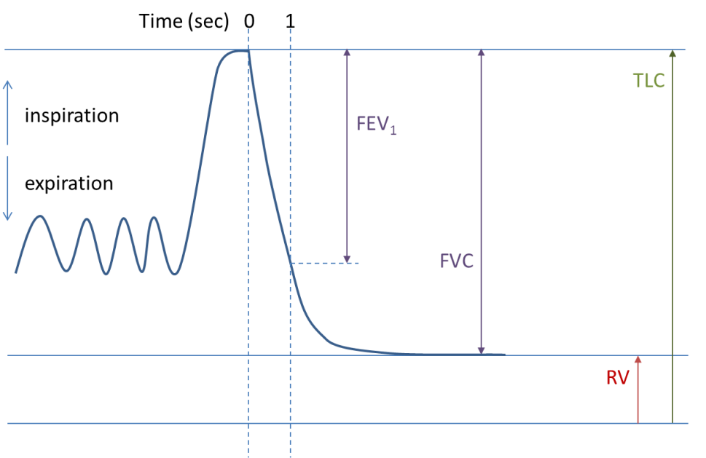
Diagnosing Childhood Asthma – Spirometry - 1

Slide 8
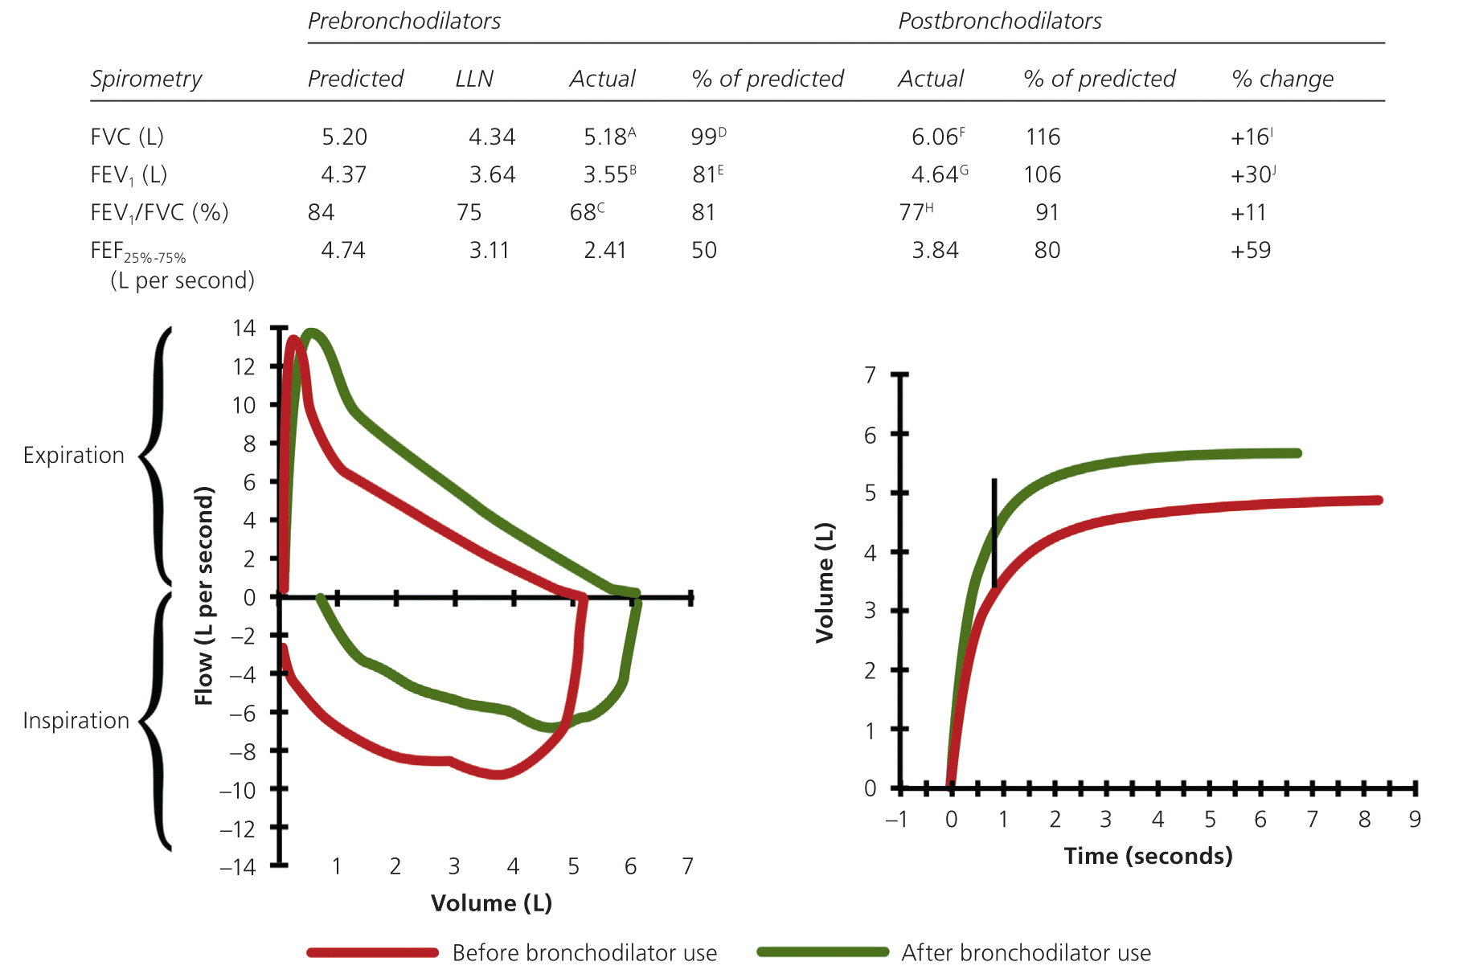
Diagnosing Childhood Asthma – Spirometry - 2

Slide 9
Diagnosing Childhood Asthma – FeNO
Fractional Exhaled Nitric Oxide (FeNO)
Marker of eosinophilic inflammation
Predicts steroid responsiveness/reflects compliance
Normal < 35
False positives (rhinitis, ?eosinophilic oesophagitis/bronchitis)
Difficult under age 5
Not been shown to effectively guide treatment
Needed in primary care???

Slide 10
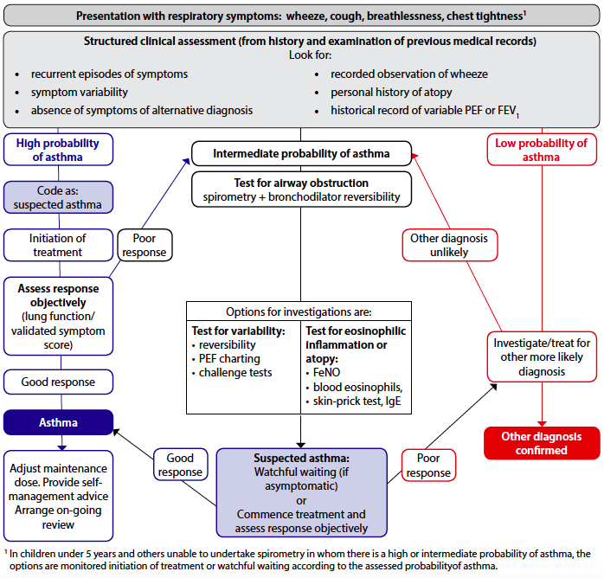
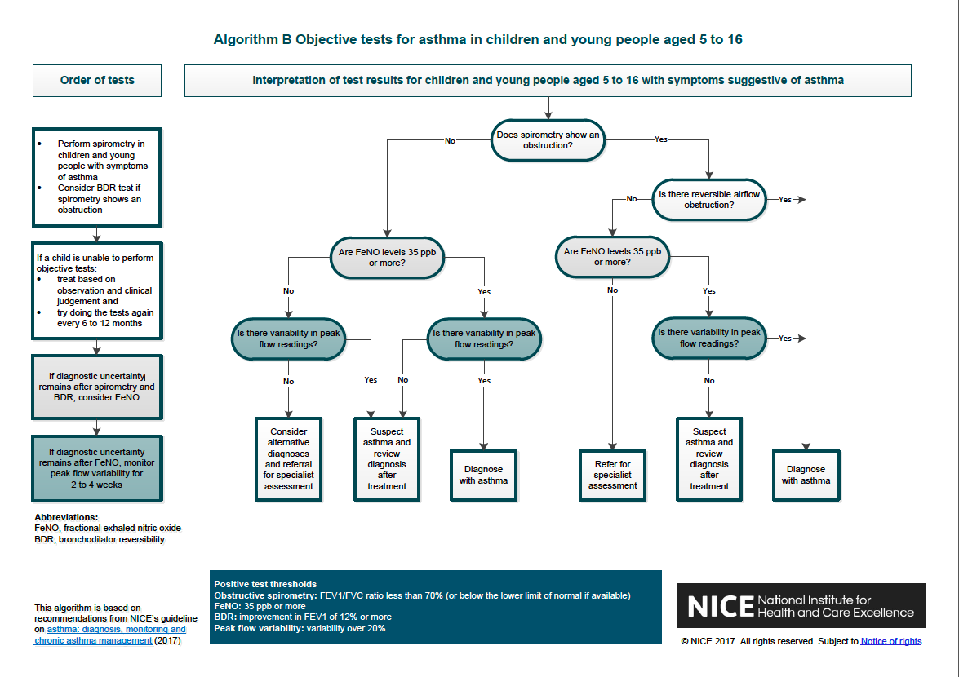
Diagnosing Childhood Asthma – NICE vs BTS - 1

Slide 11
Diagnosing Childhood Asthma – NICE vs BTS - 2

Slide 12
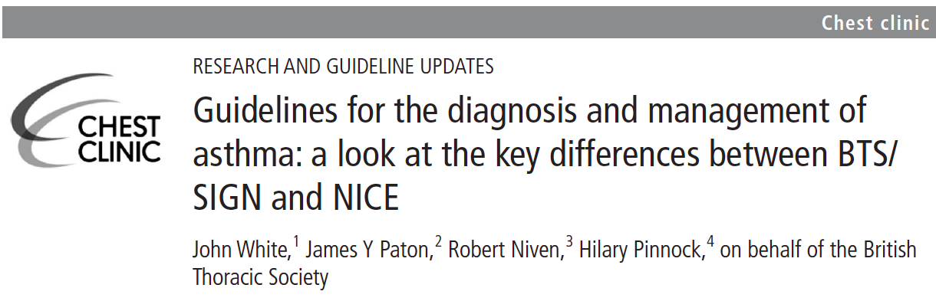
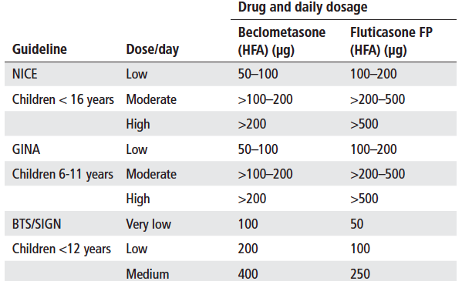
Diagnosing Childhood Asthma – NICE vs BTS - 2

Slide 13
Diagnosing Childhood Asthma – A NICE-r Way?
Suspected Asthma
Episodic cough & wheeze, viral/nocturnal/exercise symptoms, Salbutamol response
Diurnal/Symptomatic variation in lung function (PEFR/FEV-1), Other Atopy
Troublesome Symptoms
Salbutamol used > 3 days/week
Disturbed sleep, School absence, Exercise limitation
Hospitalisation, Requires oral steroids, ACT Score <19, PEFR < 80% predicted
Initiate Preventer Treatment
Age < 5 – Clenil Modulite 100mcg BD via MDI and spacer (mask or mouthpiece)
Age >5 – Clenil Modulite 200mcg BD via MDI and spacer (mouthpiece), PRN Salbutamol
Assess ACT Score, PEFR after 3 months
Symptoms Resolved?
Reduce/Stop Treatment
Reassess ACT Score, PEFR
Restart/escalate or Reduce/discontinue
Symptoms Persist
Age < 5 – Add montelukast 4mg OD
Age > 5 – Start Seretide 50, TT BD via MDI + spacer
Reassess ACT Score, PEFR
Symptoms Persist?
Monitor
ACT, PEFR
Salbutamol Px, Prednisolone Px
School Absence, ++USMA
Cause for Concern?
YES
NO
Increase Steroid dose/Add montelukast 5mg
Reassess ACT Score, PEFR
Symptoms Persist?
Refer Secondary Care*

Slide 14
Diagnosing Childhood Asthma – 2ary Referral
X

Slide 15
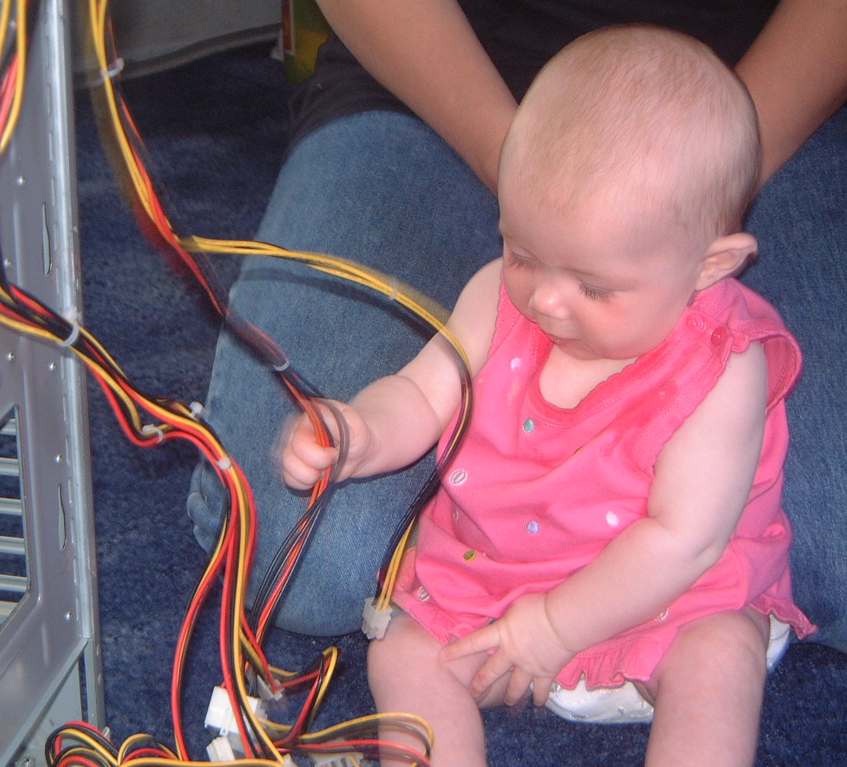
Differentials – A case history - 1
TC – 13 years old, chronic “asthma”
Born like:
Presents like:
Cough
Wheeze
Exercise limitation
Reduced FEV1
Adm with “LRTI”

Slide 16

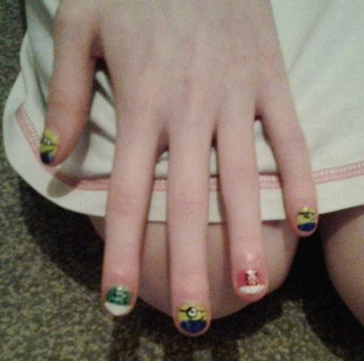
Differentials – A case history - 2

Slide 17
Differentials – A case history - 1
Closer investigation
Cachectic and stunted (wt 30kg @ 13y)
Clubbed, Lifelong steatorrhoea, Wet cough, sputum
Exercise capacity 30y (when well)
FEV1 33%, nocturnal hypoxaemia
Sweat [Cl⁻] = 95mmol/L, Stool elastase = <200mcg/g
x2 CF genes → Dx confirmed
A lifetime of mismanagement...
What happened???

Slide 18
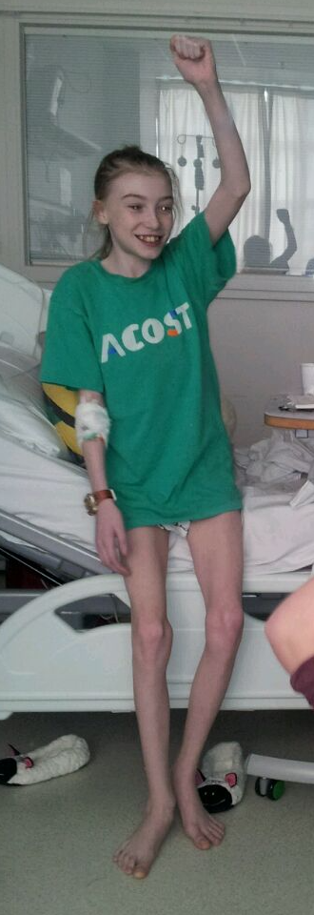
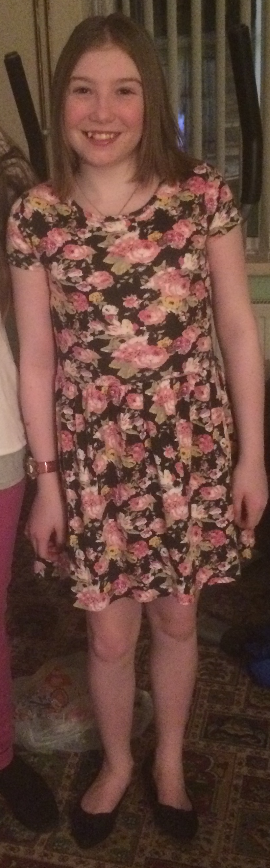
Differentials – A case history - 1
60kg
FEV1 99%
No clubbing
Sporty
Sporty++
Take a good history!!!
Engaged with CF treatment
Started on CFTR modifier
6 months later
30kg
FEV1 33%
Clubbed
Invalided

Slide 19
Differentials – A case history - 2
JB 10y male – referred for an expert legal opinion, alive.
ARE HIS ASTHMA SYMPTOMS RELATED TO POOR HOUSING????
Facts of case: Substandard housing (damp, mould, cold, wet) – flat deemed unfit for human habitation. Got better on moving to drier flat.
Current Status: on clenil modulite 100mcg BD, no pred, no hosp adm, multiple USMA (ED/GP), persistent cough, wheeze, poor sleep.
CLAIM FOR DAMAGES RELATES TO PROPERTY AND HEALTH

Slide 20
Differentials – A case history - 2
Past Medical Hx:
Ex 30 wk preterm, Bwt 1.6kg, Curosurf, CPAP 3d, O2 8d,
Slow to establish oral feeding
Started inhaled steroids after ineffective brief trial salbutamol
Symptom Pattern:
Transient early eczema (no hayfever, allergies)
Thriving (99th centile height and weight)
History of chest pain, bitter taste in mouth, no dysphagia
Cough (throat clearing - wet) first thing in morning, every morning
“WHEEZE” is actually stridor...

Slide 21
Differentials – A case history - 2
Examination:
Thriving (Wt and Ht both on 99th centile)
Some coarse breath sounds, R>L
No Harrison sulcus, clubbing, eczema, rhinitis
Hypermobile
Investigations so far:
ACT 14 (acceptable symptom control is >19)
FEV-1 111% predicted, FVC 111% predicted
FeNO 6, 8, 8 PPB (robustly normal)
Skin Prick test to common aeroallergens (incl moulds) - negative
Chest x-ray – RUL changes

Slide 22
Differentials – A case history - 2
Conclusion:
Not asthma
Not caused by housing situation
Likely Diagnosis:
Gastrooesophageal reflux with aspiration
Ex preterm, IUGR (small airways)
Outcome:
Housing Co settled case

Slide 23
Diagnosing Childhood Asthma – Acute Differentials
Differential | Key Features | Test/Intervention
Anaphylaxis | Rapid Onset May be stridor/rash/swelling May be no allergen exposure hx May be no urticaria/oedema | Adrenalin Autoinjector – if in doubt. Give it!!!
Inhaled Foreign Body | Young but mobile age Sudden onset “Choking” history (Monophonic) wheeze | Chest/C-spine X-ray Urgent ENT referral
Croup | Viral history Stridor Barking Cough Perhaps drooling | Calm Oxygen Oral/neb steroid Consider ENT/Anaesth
Bronchiolitis | Age < 1y, time of year Viral hx, Crackles | Supportive therapy
Differential | Key Features | Test/Intervention
Diabetes | Acidosis, severe hyperglycaemia ?Neurological compromise Sighing respirations | Blood sugar/ketone check Insulin, Fluid, ?ICU NOT OCS/beta agonist
Cardiac Failure | Crackles/oedema Wheeze Hepatomegaly | Chest x-ray, Echo Diuresis, fluid restriction, Oxygen, ?inotropes, ICU
Pneumonia | Fever, Wet cough, Sputum, focal signs | Consider CXR IV abx, oxygen, antipyretics
Anxiety/Habit/Psychogenic | Rapid onset Emotional turmoil/stressors Distractibility Lack of objective clinical signs Disproportionality Atypical persistent cough | Diagnosis of exclusion Caution key If clinical doubt, treat as asthma

Slide 24
Diagnosing Childhood Asthma – Chronic Differentials
Differential | Key Features | Test/Intervention
Tuberculosis | Contact history Weight loss, low grade fever Lymphadenopathy, CXR change | TST, IGRA, CXR TB rx, via specific team
Interstitial Lung Disease | Dry cough, clubbing, hypoxia, fine crackles | CT chest, resp team referral
Tracheobronchomalacia | Stridor predominates Beta agonist ineffective or harmful ?dysphagia (oesophageal compr) | CXR Echo CT PA Bronchoscopy
Dysfunctional breathing/Vocal Cord Dysfunction | Older child, athlete, upper airway symptoms, exercise sx | Spirometry Physio/SLT/psych
Anxiety/Psychogenic | Some overlap with above | Psychology
Differential | Key Features | Test/Intervention
Bronchiectasis/Persistent bacterial bronchitis | Wet cough, ?clubbing ?chest crepitations Progr/persistent symptoms Specific features | Chest imaging Cough swab, Sputum sample Specific investigations (e.g. sweat test, imm screen, nasal NO)
Chronic Aspiration (reflux) | Wet OR dry cough Nocturnal/Exercise sympts Post-prandial sympts Chest/epigastric pain Regurgitation, vomiting Hypermobility/TOF repair Poor/excess drinking | Specific targeted history Upper GI contrast Impedance study Milk scan Trial of therapy
Chronic Aspiration (unsafe swallow) | Wet cough, ?abn neurology Symptoms with fluids Poor oral intake | SLT review (?VF) ENT/neuro review (pending above) Thickened feed/NBM/bulbar training

Slide 25
Differentials in Childhood Asthma – Key pointers
Inconsistent history or clinical features
  Lack of atopy
  No history of actual wheeze (even in children with multiple admissions)
  Clear features of other diagnosis (clubbing, steatorrhoea, stridor)
Failure to respond as expected to treatment
  Recurrent exacerbations despite good compliance at decent doses
  Failure to comply may also indicate patient recognition of incorrect diagnosis
High symptom score in context of normal pathophysiological testing
  No bronchodilator reversibility/normal PEFR/exercise challenge
  Lack of eosinophilia in sputum or blood, low IgE, FeNO low
If in doubt, SHOUT!

Slide 26
Thank You
Cases from personal experience?
Queries?

